Slide 1
LendingClub Loan Default Prediction
786,820
finalized loans, 2012 to 2015
4
models compared
UE24CS352A Machine Learning | Mini-Project
Sohan MR and Sinchana Kulkarni
0.7245
best test ROC-AUC
Notes:
Introduce the project and both team members. One line: we predict whether a LendingClub loan will be fully paid or default, using only information known at application time.

Slide 2
The problem: who will repay?
The risk
Peer-to-peer investors lose money when a borrower defaults. Credit risk is their main concern.
1
Fully Paid
1
The task
Binary classification from information available when the application is made.
2
0
Default / Charged Off
The goal
Catch as many defaults as possible without wrongly rejecting too many good loans.
3
Notes:
Frame the problem as a business one. Label 1 = Fully Paid, label 0 = Default or Charged Off. Inspired by the Stanford CS229 report by Li and Han (2018): we keep its 2012 to 2015 period and model families, but avoid features that reveal the outcome.

Slide 3
Dataset: 786,820 finalized loans
2.26M
786,820
81.4%
27
raw rows, 151 columns
after filtering
Fully Paid
features (20 numeric, 7 categorical)
Class balance after filtering
Fully Paid 81.4%
Default 18.6%
Source: Kaggle, Lending Club Loan Data (accepted_2007_to_2018Q4.csv, about 1.6 GB). Kept loans issued 2012 to 2015 with a final outcome (Fully Paid, Charged Off, Default); Current and Late loans were dropped.
Notes:
Raw file: 2,260,701 rows and 151 columns. After keeping 2012 to 2015 loans with a final outcome we have 786,820 loans, 81.4% Fully Paid. The imbalance matters: always predicting Paid already gives about 0.81 accuracy.

Slide 4
Avoiding data leakage
Used: known at application time
Excluded: reveal the outcome
Loan amount, term, interest rate
Grade and sub-grade
FICO range, DTI, annual income
Credit history and employment length
Purpose, home ownership, state
total_pymnt
recoveries
last_pymnt_d
Any other post-origination payment column
Using outcome-revealing columns would inflate every score, so we kept 27 application-time features only.
Notes:
Leakage is the biggest trap in this dataset. Columns like total_pymnt, recoveries and last_pymnt_d are only known after the loan has played out, so they would let a model 'cheat'. We use only application-time features. Likely Q&A: why does our AUC look lower than papers that report 0.89? Because we exclude these columns and report per-class metrics.

Slide 5
Pipeline
Filter Loans issued 2012 to 2015 with a final outcome.
Data split
1
Train 60%
Split Stratified 60 / 20 / 20 into train, dev and test.
2
Preprocess Impute, scale, one-hot encode. Fit on train only. 136 features.
3
Train Four models, each with class-imbalance handling.
Dev 20%
4
Test 20%
Tune and test Pick threshold on dev, report on test.
5
Notes:
Preprocessing is fitted on the training set only to avoid leaking dev or test statistics. The dev set is used only to choose the decision threshold; the test set is touched once for final numbers. 136 features come from 20 numeric plus one-hot encoded categorical columns.

Slide 6
Four models, one imbalance fix each
1
Logistic Regression
2
Neural Network (MLP)
class_weight = balanced. Simple, interpretable baseline.
Layers 32-16-8, ReLU. Trained on a 1:1 undersampled set.
3
Random Forest
4
HistGradientBoosting
100 trees, depth 12, class_weight = balanced_subsample.
Balanced sample weights, 300 iterations, learning rate 0.05.
Threshold tuning: the cut-off on P(default) that maximises Default-class F1 on the dev set is applied to the test set.
Notes:
MLPClassifier in scikit-learn has no class_weight option, so we undersample the majority class 1:1 for it. The other three models use class weights. Then we move the decision threshold away from 0.5 using the dev set; the tuned thresholds were about 0.53 to 0.54 on P(default).

Slide 7
Lesson from v1: accuracy hid the problem
0.81
accuracy from always predicting Paid
0.82
accuracy of v1 MLP and Random Forest, yet they missed 93% and 96% of defaults
Notes:
Our first version (lending_club_classifier.py) used no class balancing for the MLP and Random Forest. They scored 0.82 accuracy but caught only 7% (MLP) and 4% (Random Forest) of real defaults because they predicted Paid almost every time. Class weighting, undersampling and threshold tuning in v2 raised Default recall to about 58%. This is why we report ROC-AUC and per-class metrics instead of accuracy alone.

Slide 8
Results on the held-out test set
Model | ROC-AUC | Default recall | Default precision | Default F1
Logistic Regression | 0.7185 | 0.596 | 0.325 | 0.420
Neural Network (MLP) | 0.7189 | 0.583 | 0.328 | 0.420
Random Forest | 0.7147 | 0.580 | 0.324 | 0.416
HistGradientBoosting | 0.7245 | 0.609 | 0.327 | 0.426
157,364 test loans. Recall, precision and F1 are for the Default class at the dev-tuned threshold.
HistGradientBoosting is best (AUC 0.7245), but only about 0.006 ahead of Logistic Regression.
Notes:
Numbers come from results_summary.csv written by lending_club_classifier_v2.py. At the dev-tuned threshold the models catch roughly 58 to 61% of defaults with about 32 to 33% precision. Accuracy at the tuned threshold is about 0.69 to 0.70, which is lower than v1's 0.82 on purpose: we trade accuracy for catching defaults.

Slide 9
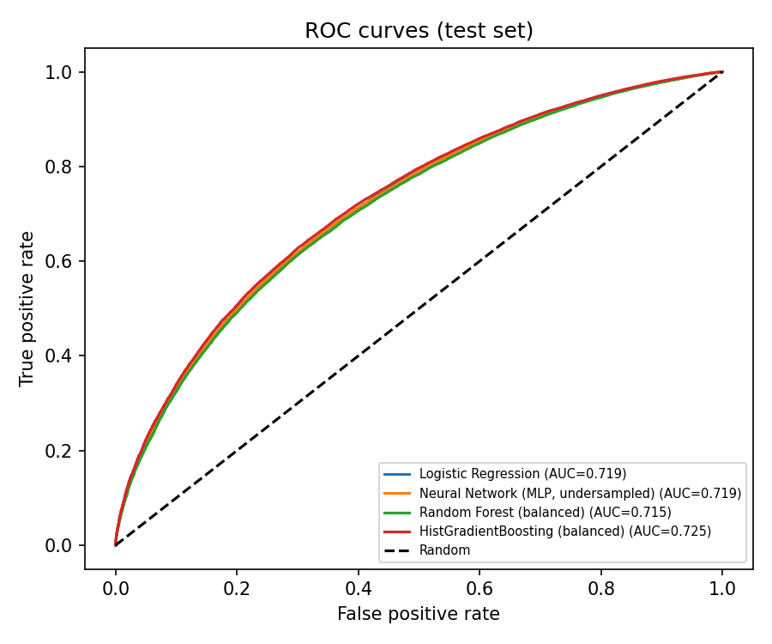
ROC curves: all four models overlap
0.7245
best test ROC-AUC (HistGradientBoosting)
Curves nearly coincide: AUC ranges only 0.715 to 0.725
With application-time features, every model plateaus near 0.72
Tuned thresholds sit near 0.53 on P(default)
Notes:
ROC-AUC measures how well each model ranks defaulters above payers, independent of the threshold. The near-identical curves suggest the limit is in the information in the features, not in model complexity.

Slide 10
Limitations and next steps
1
Drop grade, sub_grade, int_rate
2
Feature importance
Retrain without LendingClub's own risk assessment to measure the models' independent signal.
Add importance for the boosting model to see what drives default predictions.
3
Test on 2016 to 2018 loans
4
Regression and loan selection
Check generalization over time on finalized later loans.
Add the profitability regression and selection strategy from the reference paper.
Notes:
Be honest about limits: grade, sub_grade and int_rate encode LendingClub's own credit assessment, so part of our signal may simply be theirs. The reference paper's 0.89 weighted precision and recall is not directly comparable to our per-class metrics, since we also exclude outcome-revealing columns.

Slide 11
Conclusions
1
2
3
Boosting wins narrowly
A plateau near 0.72 AUC
Imbalance handling mattered most
HistGradientBoosting reaches AUC 0.7245, only about 0.006 above Logistic Regression.
Application-time features limit all four models, regardless of complexity.
Balancing and threshold tuning lifted Default recall from 4 to 7% to about 58 to 61%.
Notes:
Close with the three messages. Then invite questions. Be ready to explain: why leakage columns were dropped, why accuracy misleads at 81/19, how class weighting, undersampling and threshold tuning work, why the dev set is only for the threshold, and why AUC plateaus near 0.72.

